Slide 1
The effects of Covid-19 on social work with children and parents. Or Being helpful in Social Work
Harry Ferguson, Prof of SW, University of Birmingham
@harr_Ferguson

Slide 2
Covid-19 Research
How can practices that have relied on achieving closeness keep children safe and help families in a period of institutionalised social distancing?
Professor Harry Ferguson (University of Birmingham, UK, PI) @harr_ferguson
Professor Sarah Pink (Monash University, Australia) @pinkydigital
Dr Laura Kelly (University of Birmingham) @laura_c_kelly

Slide 3
Methodology
Based in four (anonymous) local authorities
Qualitative - longitudinal approach
Interviews with 48 SWs, FSWs & managers every circa 4 weeks (for 8 months)
Case-study approach: data on work with selected families over time
Interviewed 21 parents and 1 g/parent in these cases.
Notes:
exploring challenges in sustaining relationships & effective CP

Slide 4
What does helpful practice look like?
What are the most important components of being helpful?
Choose one and write it in the chat box.
Notes:
exploring challenges in sustaining relationships & effective CP

Slide 5
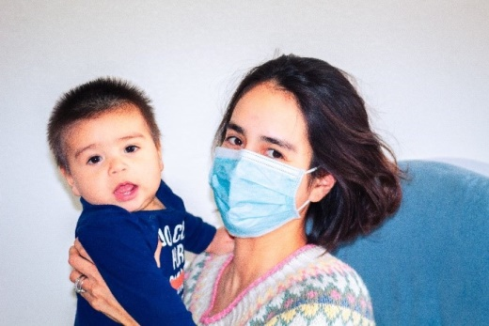
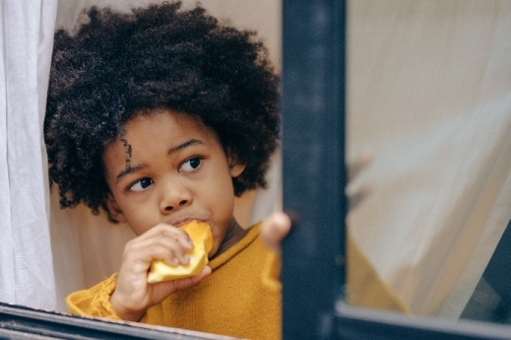
Ethical practice and the desire for closeness
SWs regularly choosing to act with selflessness and integrity
“Children being safe is as important as Covid, I can’t not go into houses, I can’t not see children on their own”
But practitioners need to be protected from taking too many risks.
Notes:
Philp (2020) asks, ‘What does the principle of selflessness ask of social care workers and what is it reasonable to ask of public servants?’
Are professional ethics driving SWs to take too many personal risks?
What should managers do to keep staff and families safe?

Slide 6
Closeness / intimacy
Distancing is difficult: Touch often still being used
4 year old girl: “likes to come and put her head on my knee, I think it is almost like a comfort thing, I think she slightly understands that I am there trying to help.”
Uncertainty of home visits, small properties / spaces
General concern about effects of wearing PPE, especially masks (when they were available).
Notes:
– eg father found hiding in bedroom
“They can’t see my expressions, so I’m more mindful in what I say, using language to reinforce, I’ll name it more. I hate wearing the mask, it’s horrible, I feel frustrated and flustered in it, it does impact on my concentration, you get hot even if not wearing full PPE. It definitely does make a difference.”

Slide 7
Courage
“It was a complicated time, it’s a very small area and they weren’t allowed out and stuff like that. … And [Tom’s] great with advice, he gives us advice. Which is really positive. And even if he can’t solve things just knowing that you’ve got someone to tell or something to say it is a massive help I feel. … [After being ill with COVID-19] I mean he was probably the only person that was brave enough to visit us. So that was great.” (Mother)

Slide 8
Outcomes: care proceedings, removal of children
Covid has made life harder - poverty, mental health problems, domestic abuse
Absence of addiction & other therapeutic services
Children removed who may not otherwise have been
Human rights issues re meaningful parental participation in decisions, court, family time.

Slide 9
Perseverance
April 2020 3 children: 3, 6 and 8. Domestic abuse, ‘neglect’, CP plan, PLO
“I still visit every ten days like I usually would. … What is different is that I am not able to see the children alone in the same way that I would like to, in school as well as at home, and the way their house is, it is very difficult to find anywhere that is particularly private to speak to the children so I guess that kind of part of the work is different.”
The children had a domestic abuse support worker, who had stopped doing visits. School called over the phone to speak to the children and their mum, ‘Susan’, but the phone was put on loud speaker by Dad, “so it becomes quite difficult to then get a true picture because we’re really aware that calls are being listened in to and we might not be being told everything because he is there listening.”

Slide 10
April 2020 continued
On home visits ‘Ray’ (father) was often very aggressive towards the SW, who did joint-visits with SWA.
Of her relationship with Susan the SW said: “She is starting, initially she was really closed, really not wanting us to be involved, she is starting to open up slightly, starting to talk about how she might leave him, so that is positive in terms of our relationship together, it is just difficult to know how honest she is being.”
“it is really hard to maintain social distancing with a 3 year old, especially one like her because she is really keen to play and climb on me and you know in normal times that is fine. So that is hard, … but other than that, I am glad to be able to go. I would be really worried about these children if I couldn’t go.”

Slide 11
October 2020
Social worker: “He said I create problems in their family to warrant my existence, ‘I’m sick of hearing your fucking name’. So it’s not going great, to be honest. ((sighs)) I don’t know. … Care of the 3 year old is good enough and there’s been no domestic violence incident since May, he’s stopped drinking. Things are better … in fairness to them. He says he’s stopped drinking because he doesn’t want to lose his kids. He drinks and becomes aggressive and that’s what we are worried about. And I’ve not had anything to suggest he’s not being honest about that. I have a good relationship with mum, I’m straight with her, she tells me things she could get away with not telling me. I really want her to turn things around.”

Slide 12
October 2020
Susan / Mother: “We’ve been lucky we’ve got a very nice SW, it was hard at the beginning but once we’ve got to know her we can go to her if we need anything.
The SW has seen the children in school on their own and if they’ve got any worries they can see her on their own, in the kitchen or the living room or they would go round the block for a walk. … During lockdown a lot of it was done over Skype or phone. The video calls were strange to start with, it was just like talking face to face really, quite relaxed, easy going.
When she visits we sit in the living room, she wears gloves and a mask, she sees the kids and we have a chat, it’s quite relaxed really. We are getting used to the PPE now, it was very surreal and strange in the beginning, we’ve kind of adapted to it now, it’s just a precaution. … PPE has not affected how helpful they’ve been able to be and it definitely hasn’t affected how they work with the children. The social worker is brilliant with them.
I think we’ve got a good relationship, we’re up front with each other. She hasn’t judged, she’s been tough when she’s needed to, she doesn’t hide things, she’s up front no matter how hard it is to hear it, which has really helped. There have been times when we haven’t wanted to hear things, she’s wanted things to change that we don’t want to. But she’s honest with us and we work together to find solutions, but she’s understanding as well.”

Slide 13
November 2020
Ray/Father: On visits during the pandemic we’ve admitted there’s a few things that could be changed in our house, there’s no manual about being a parent. It’s been quite hard, I’m not one who likes to be told what to do. She has been helpful – she got us to see there are things we have to change. She sourced a bed, she’s going to get us a cot. Every case is different and with the one we’ve got and she’s come in and rather than stereotyping she’s looked at it in an individual way, so I think that’s helped. She’s helped when I said can I get help with a bed, I’m a proud man. She’s not trying to tick the boxes. She had a list, she had some things her people told her what to do and she didn’t bother going through them all. Some social workers go through it even if they don’t need to because they have been told to. [The previous SW didn’t interact with the children]. The one we’ve got now interacts with all of us, the other SW would snatch her bag away. The current SW interacts with the children, asks how they are, brings them little bits, games, clothes, talks to them directly rather than through us, she walks through the house.

Slide 14
Reliability
Turning up, even when not welcome, persevering
Not retaliating when they are angry, rejecting …
Humane practice: Provision of material support, food
Not just about ‘care’ but good use of authority
Placing limits on parents, some teenagers
Touch & closeness are therapeutic & central
Provided nurture when children needed it.

Slide 15
Relational practice – A ‘holding relationship’
When could not hold children physically, held them and parents in mind
Through a deeply meaningful relationship
Demonstrating care for and about them
Container for the processing of trauma, hostility, care
Trusting relationship develops self-efficacy, skills, confidence, esteem.
Notes:
Progressed CP & CIN plans = helpful SW

Slide 16
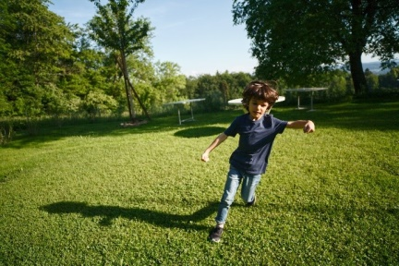
Innovative practice
Spatial shift - away from interior of the home & into gardens, parks, walking interviews
Creative and playful improvisations
Invest in shoulder-to-shoulder work
Temporal shift - often having more contact
Spread out over time and a range of platforms
Hybrid approach combining telephone calls, video calls, text messages, images, film (WhatsApp) and in-person
Having more contact with some families
Spread out over a range of formats, spaces.

Slide 17
Future digital / hybrid practice
Benefits for prof meetings, with some concerns re including families
‘Virtual visits’ stopped quickly – seen as a last resort – but are benefits
Most parents we interviewed adapted to digital support, and some also reported positive feedback from their children
Potential for SW to offer continuous support to families & other professionals
Must be attentive to inequalities and digital exclusion
WhatsApp messaging has grown, within teams & with SUs
Increase the visibility & appreciation of what social workers do.

Slide 18
H.Ferguson.3@bham.ac.uk
@harr_Ferguson
Research web pages: https://www.birmingham.ac.uk/child-protection-and-social-distancing

